Slide 1
Differentiable Neural Computers

Slide 2
Differentiable Neural Computer
The Differentiable Neural Computer is a neural network which takes advantage of memory augmentation and, at the same time, the attention mechanism
The Differentiable Neural Computer model came from deep mind a few months ago, and is the successor to the Turing machine. This is a relatively complex model
The core problem faced by the deep learning team is how to create a more general purpose learning machine - and that is the pretext for building this model.

Slide 3
Difference between NN and DNN
The problem with neural networks are that they are made to focus on a single task or whatever you train it on.
You can’t use the same neural network that learned to recognise music to learn to navigate say the London Underground.
The DNN is a neural network with an external memory store, so it has two parts - the controller which is normal NN , like a feed forward net or a recurrent net or anyone you want.
Then you have the memory bank, which is an external matrix, the controller interacts with the memory bank using heads which is read write operations.
Takes an input, propagates it through the network, and simultaneously writes to the matrix to both write what it learned and read from the past time steps to look for useful info to help it with its prediction.

Slide 4
“This DNC is working towards achieving meta learning, in other words - learning to learn. This is the edge of deep learning” Siraj Raval

Slide 5
Evolution of DNC
Deep mind did was apply it to the London Underground. The first thing they did was generate lots of random graphs.
Subway systems are all graphs, they have nodes and are all connected, so they gave it a bunch of graphs with handcrafted inputs including labels - so its a supervised learning problem.
The labels would be different paths from point A to B. After they trained it on randomly generated graphs, then they applied it to the actual London Underground.
If you said point a to b, it would find the optimal path.
You could do this already with a recurrent network a LSTM network.

Slide 6
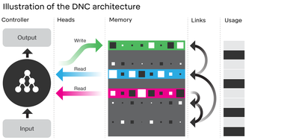
The neural network controller receives external inputs and, based on these, interacts with the memory using read and write operations known as 'heads'. To help the controller navigate the memory, DNC stores 'temporal links' to keep track of the order things were written in, and records the current 'usage' level of each memory location.

Slide 7
Finding Optimal Path with NLP
Then they added a question answering system, natural language was added. Not only did they train it on the London Underground path, they added natural language.
They trained it first on randomly generated graphs then on a text database which was a question answer database.
Then associated both, so then you could ask it “hey what’s the best way to get from point A to B , because it had this external memory story which had the previous learning graphs it was able to apply those.

Slide 8
Finding Optimal Path with NLP
It learned to optimize for one data set, then another and associate the two.
This was a text database, it learned to associate questions with answers, then associate that to the london underground map.
This is because it had the external memory store which allowed it to apply the map problem to the spoken questions.

Slide 9
Learning in Differentiable neural computers
Differentiable neural computers learn how to use memory and how to produce answers completely from scratch.
They learn to do so using the magic of optimization: when a DNC produces an answer, we compare the answer to a desired correct answer.
Over time, the controller learns to produce answers that are closer and closer to the correct answer. In the process, it figures out how to use its memory.

Slide 10
Test DNCs On Problems
We wanted to test DNCs on problems that involved constructing data structures and using those data structures to answer questions. Graph data structures are very important for representing data items that can be arbitrarily connected to form paths and cycles.
DNC can learn on its own to write down a description of an arbitrary graph and answer questions about it. When we described the stations and lines of the London Underground, we could ask a DNC to answer questions like, “Starting at Bond street, and taking the Central line in a direction one stop, the Circle line in a direction for four stops, and the Jubilee line in a direction for two stops, at what stop do you wind up?” Or, the DNC could plan routes given questions like “How do you get from Moorgate to Piccadilly Circus?”

Slide 11
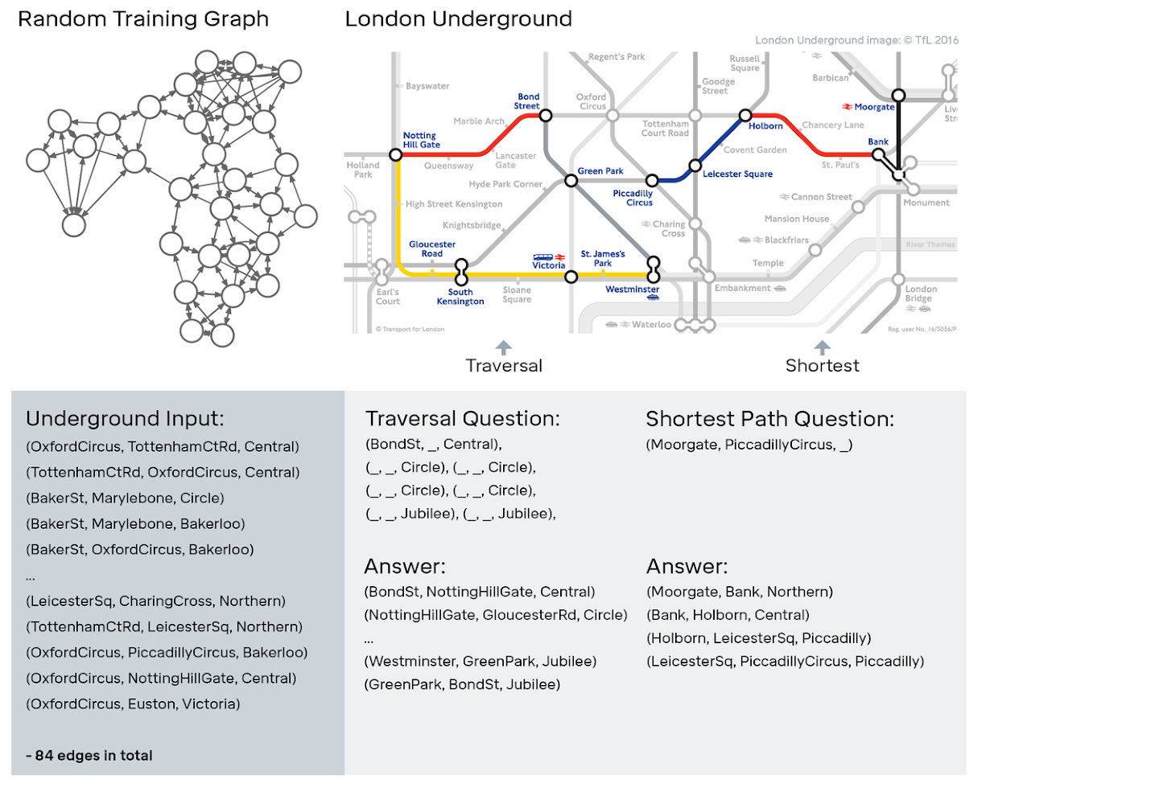

Slide 12
Family Tree Example
In a family tree, we showed that it could answer questions that require complex deductions. For example, even though we only described parent, child, and sibling relationships to the network, we could ask it questions like “Who is Freya’s maternal great uncle?”
We also found it possible to analyse how DNCs used their memories by visualising which locations in memory were being read by the controller to produce what answers.
Conventional neural networks in our comparisons either could not store the information, or they could not learn to reason in a way that would generalise to new examples.

Slide 13
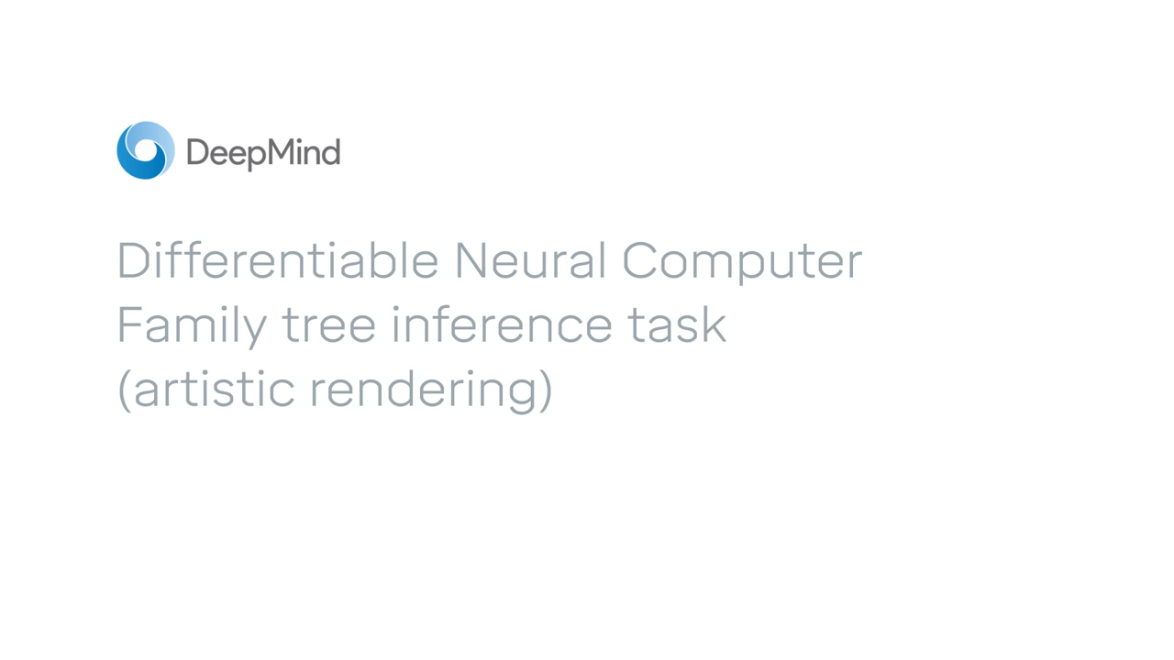
DNC -Family Tree Example

Slide 14
DNC-Structure
DNC as a machine with a CPU and a RAM.
A neural network, the controller, will take the role of the CPU. A memory, which is just a matrix, will take the role of the RAM.
Each row of the memory matrix is called location.
The matrix will have N locations, which are W-dimensional vectors. Then, the memory is an N x W matrix.

Slide 15
DNC Structure
Neural networks and memory systems can be combined to make learning machines that can store knowledge quickly and reason about it flexibly.
These models, which we call differentiable neural computers (DNCs), can learn from examples like neural networks, but they can also store complex data like computers.

Slide 16
Von-Neuman Architecture
In a normal computer, the processor can read and write information from and to random access memory (RAM).
RAM gives the processor much more space to organise the intermediate results of computations.
Temporary placeholders for information are called variables and are stored in memory.
In a computer, it is a trivial operation to form a variable that holds a numerical value. And it is also simple to make data structures – variables in memory that contain links that can be followed to get to other variables.
One of the simplest data structures is a list – a sequence of variables that can be read item by item. For example, one could store a list of players’ names on a sports team and then read each name one by one.
A more complicated data structure is a tree. In a family tree for instance, links from children to parents can be followed to read out a line of ancestry.
One of the most complex and general data structures is a graph, like the London Underground network.

Slide 17
Design of DNC
In DNCs,the machines that could learn to form and navigate complex data structures on their own.
At the heart of a DNC is a neural network called a controller, which is analogous to the processor in a computer.
A controller is responsible for taking input in, reading from and writing to memory, and producing output that can be interpreted as an answer.
The memory is a set of locations that can each store a vector of information.

Slide 18
Memory augmentation and attention mechanism
The controller will store and read information from the memory, and the network will learn how to do that by mean of some parameter vectors, but we will talk about that.
The main point is that the memory of the network is external to the network itself.
Normally, the entire knowledge of a network is stored in its weights. Instead, a DNC is something called “Memory augmented neural network”, and this peculiarity provides it with some nice features.

Slide 19
Memory augmentation and attention mechanism
The memory augmentation actually, it isn’t a new thing at all.
the DNC is the system of vectors and operations mediating between controller and memory.
This is called attention mechanism

Slide 20
Weightings and heads
The attention mechanism defines some distributions over the N locations.
These distributions are N-vectors, called weightings.
Each i-th component of a weighting vector will communicate how much attention the controller should give to the content in the i-th location of the memory.
There are more processes which require watching at the memory contents, and that’s where different weightings will take action.

Slide 21
Weightings and heads
Every process which involves operations is a functional unit in our network graph.
The units in which weightings are produced and used are called heads.
Basically, we’ll have two types of interaction between controller and memory: the reading process, mediated by mean of the read weighting, and the writing process, mediated by the write weighting.
The functional units in which this mediating action happens are called read head and write head.

Slide 22
Weightings and heads
The DNC can learn how to produce good weightings for each input, that is, it knows how to differently weight its memories on the base of their relative importance with regard to the given input.
The weighting produced for an input is a distribution over the N locations for their relative importance in a particular process (reading or writing).

Slide 23
How are the weightings determined?
The weightings are produced by mean of a vector emitted by the controller, which is called interface vector.
The interface vector is a set of values encoding the controller needs and requests to be made to the memory.

Slide 24
DNC –Write operation
A controller can perform several operations on memory. At every tick of a clock, it chooses whether to write to memory or not.
If it chooses to write, it can choose to store information at a new, unused location or at a location that already contains information the controller is searching for.
This allows the controller to update what is stored at a location. If all the locations in memory are used up, the controller can decide to free locations, much like how a computer can reallocate memory that is no longer needed.
When the controller does write, it sends a vector of information to the chosen location in memory.
Every time information is written, the locations are connected by links of association, which represent the order in which information was stored.

Slide 25
DNC –Write operation
A controller can perform several operations on memory. At every tick of a clock, it chooses whether to write to memory or not.
If it chooses to write, it can choose to store information at a new, unused location or at a location that already contains information the controller is searching for.
This allows the controller to update what is stored at a location.

Slide 26
DNC –Write operation
If all the locations in memory are used up, the controller can decide to free locations, much like how a computer can reallocate memory that is no longer needed.
When the controller does write, it sends a vector of information to the chosen location in memory.
Every time information is written, the locations are connected by links of association, which represent the order in which information was stored.

Slide 27
DNC –Read operation
The controller can read from multiple locations in memory. Memory can be searched based on the content of each location, or the associative temporal links can be followed forward and backward to recall information written in sequence or in reverse.
The read out information can be used to produce answers to questions or actions to take in an environment.
Together, these operations give DNCs the ability to make choices about how they allocate memory, store information in memory, and easily find it once there.

Slide 28
The Attention Noble Threefold Path
There are three kinds of interactions between the controller and the memory, and they are mediated by the interface vector:
Content lookup: a particular set of values within the interface vector, which we will collect in something called key vector, is compared to the content of each location. This comparison is made by mean of a similarity measure (in this case, the cosine similarity).

Slide 29
The Attention Noble Threefold Path
2.Temporal memory linkage: the transitions between consecutively written locations are recorded in an N x N matrix, called temporal link matrix L.
The sequence by which the controller writes in the memory is an information by itself, and it’s something we want to store. Just think of it in this way: if I can’t remember where I left my smartphone, I can try to remember where I was before arriving at my present position.

Slide 30
The Attention Noble Threefold Path
3.Dynamic memory allocation: each location has a usage level represented as a number from 0 to 1.
A weighting that picks out an unused location is sent to the write head, so that it knows where to store new information.
The word “dynamic” refers to the ability of the controller to reallocate memory that is no longer required, erasing its content.
Also, the allocation mechanism is independent of the size and contents of the memory, and that means that we can extend the memory without compromising or having to retrain the network.

Slide 31
Thank u

